Slide 1

Loan Eligibility Prediction Machine Learning Model
Rashini J Widanaarachchi
21 Nov 2021

Slide 2

Introduction
loans are the credit extended to us by lenders when we require additional money for different purposes. There are many loan types. e.g., Home loans, Educational loans, Business loans etc.
Customer first applies for Loan in a Financial Institution and then company validates the customer eligibility for loan before facilitating the loan.
Customers who are ineligible for loan are considered as people who have difficulty in paying back the loan.
Factors determine the loan eligibility
Credit Score
Income and Employment History
Debt-to-income ratio
Availability of co-signer

Slide 3
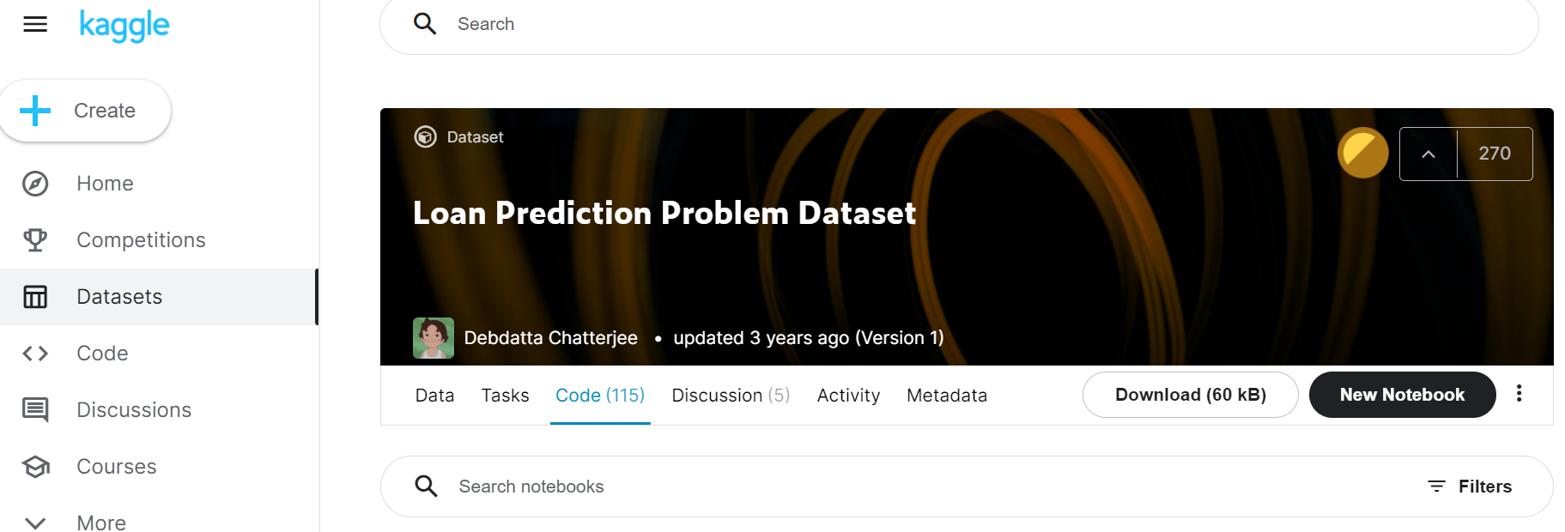
Problem Definition
A company wants to automate the loan eligibility process (real time) based on customer details provided while filling online application form.
For this a machine learning model is developed which can predict the loan eligibility.
The Data for the problem has been obtained from Kaggle Platform. (https://www.kaggle.com/altruistdelhite04/loan-prediction-problem-dataset/code)

Slide 4

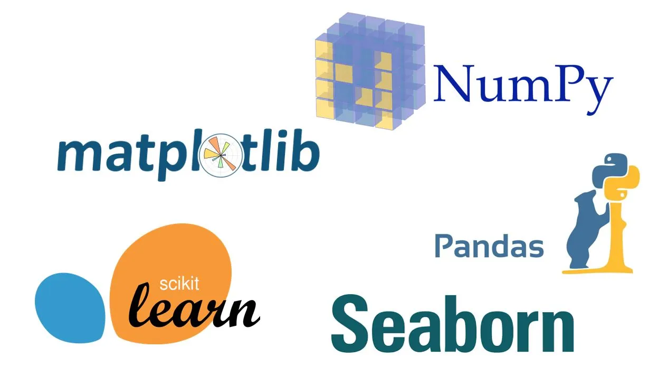
Data Extraction & Tools used
The data contained 614 rows data with 13 variables including customer details which have been provided in requesting a loan.
These data were extracted to a csv format and accessed through python programming tool for the model development.
The packages used are as follows;
Variable | Description
Loan_ID | Unique Loan ID
Gender | Male/ Female
Married | Applicant married (Y/N)
Dependents | Number of dependents
Education | Applicant Education (Graduate/ Under Graduate)
Self_Employed | Self employed (Y/N)
ApplicantIncome | Applicant income
CoapplicantIncome | Coapplicant income
LoanAmount | Loan amount in thousands
Loan_Amount_Term | Term of loan in months
Credit_History | credit history meets guidelines
Property_Area | Urban/ Semi Urban/ Rural
Loan_Status | (Target) Loan approved (Y/N)

Slide 5
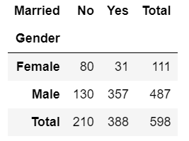
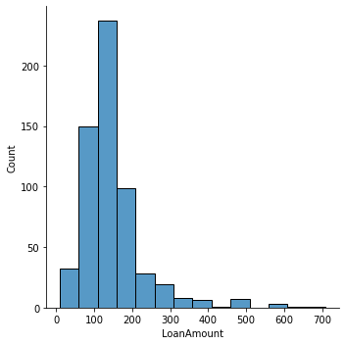
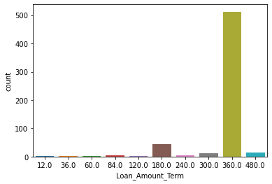
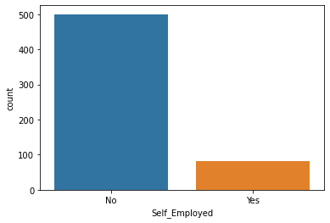
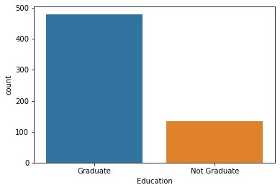
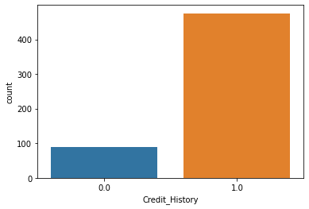
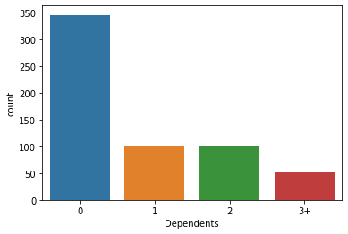
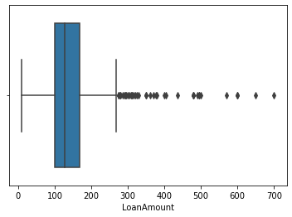
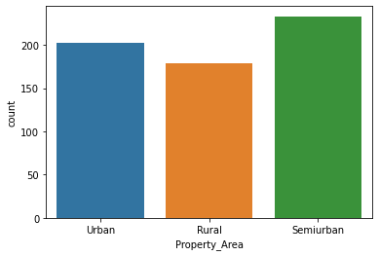
Exploratory Data Analysis (EDA)

Slide 6
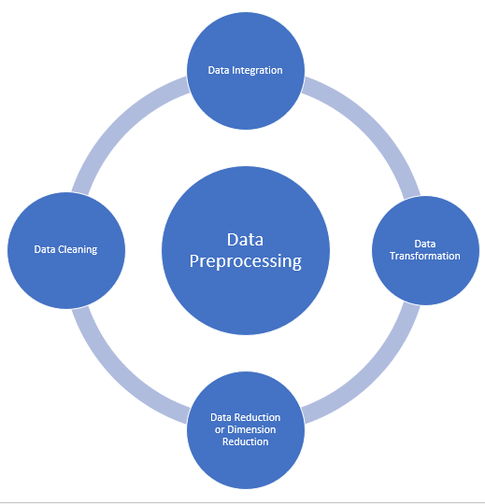
Methodology - Data Preprocessing
The null values of categorical variables has been filled up with the modes of relevant fields.
The loan amount null values have been filled up with the median value due to availability of outliers.
To reduce the categories with low frequencies; The loan amount term variable has been grouped in 10-year groups.
To improve the accuracy/precision of the model the categorical variables (Loan_Amount_Term_grp, Property_Area and Dependents) have been broken down into dummy variables.
Definite set of X variables are selected by measuring the relationship within the dependent variables and among dependent and independent variable using correlation matrix.

Slide 7
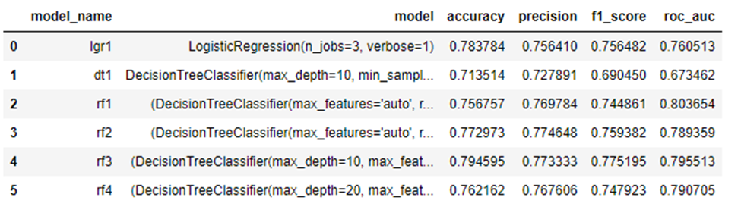

Model Building
Problem : Binary Classification
Machine Learning Methods tested - Logistic Regression, Decision Tree Classifier and Random Forest Classifier
Metric used for Model Comparison – Precision
Reason for using Precision- False positive values in the model output will represent the customers as credit worthy but in real world those customers don’t have an eligibility to pay back the loan. Which will be a cost to the company.

Slide 8
Result
The finalized Model
The finalized model consists of high precision and as well as high accuracy comparatively.
Comparatively the Random forest Machine learning method is used as the best model for the problem to predict the eligibility of loan for the applicants.

Slide 9

Conclusion
The finalized model is saved.
This model will be used in an API which will give the predicted output where the customer is eligible for the loan or not once the customer details are provided.
The loan process will be automated.

Slide 10
Thank You

